Slide 1

How Severe is an Insurance Claim?
Machine Learning Kaggle Team Project
SVC Team

Slide 2
Why Do We Care & What Do We Want to Find Out
Allstate, a personal insurer in the United States, is continually seeking fresh ideas to improve their claims service for the over 16 million households they protect.
Allstate is currently developing automated methods of predicting the cost, and hence severity, of claims. In this recruitment challenge, Kagglers are invited to show off their creativity and flex their technical chops by creating an algorithm which accurately predicts claims severity. Aspiring competitors will demonstrate insight into better ways to predict claims severity for the chance to be part of Allstate’s efforts to ensure a worry-free customer experience.

Slide 3
Background knowledge of the dataset
Each row in this dataset represents an insurance claim. You must predict the value for the 'loss' column. Variables prefaced with 'cat' are categorical, while those prefaced with 'cont' are continuous.
File descriptions
train.csv - the training set
test.csv - the test set. You must predict the loss value for the ids in this file.
sample_submission.csv - a sample submission file in the correct format

Slide 4
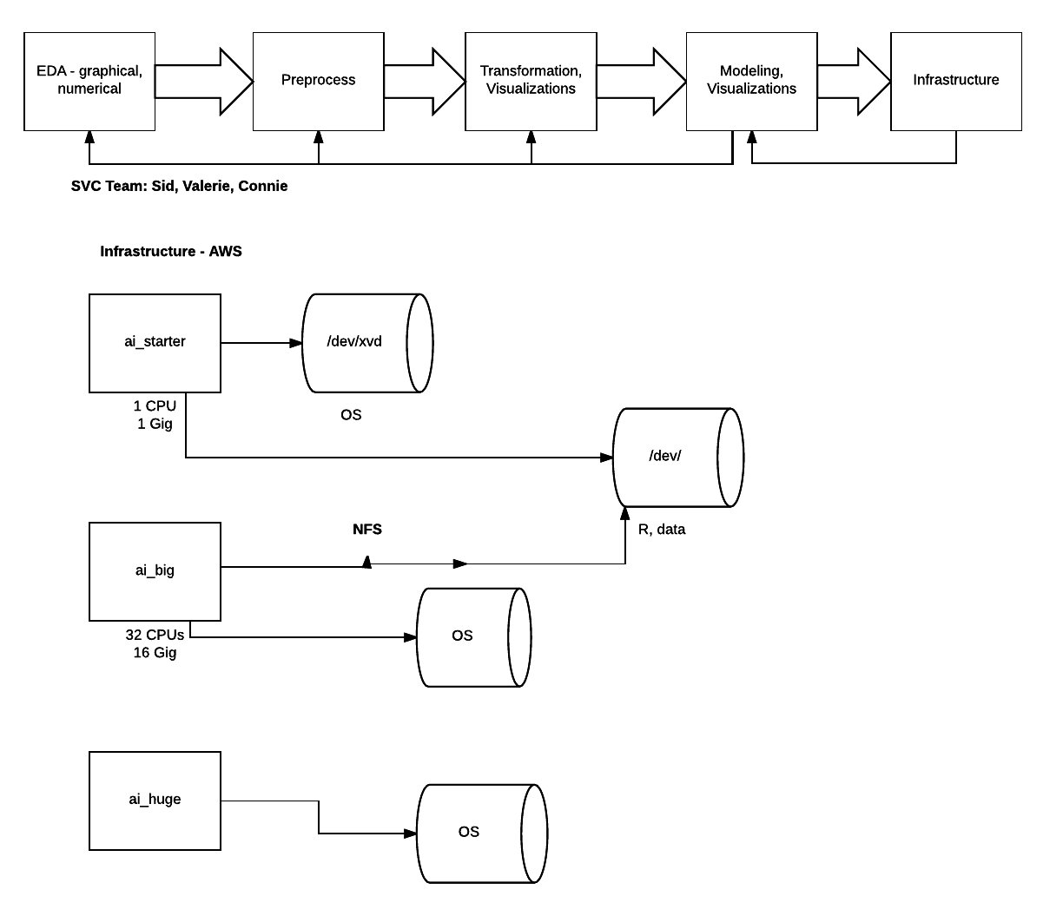

Slide 5
The Data
Training Dataset
Observations: 188318
Categorical Variables: 116
Continuous Variables: 14

Slide 6
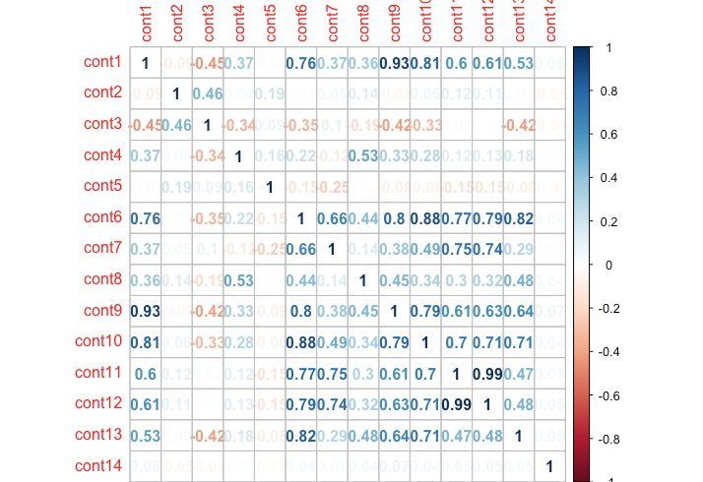

Slide 7
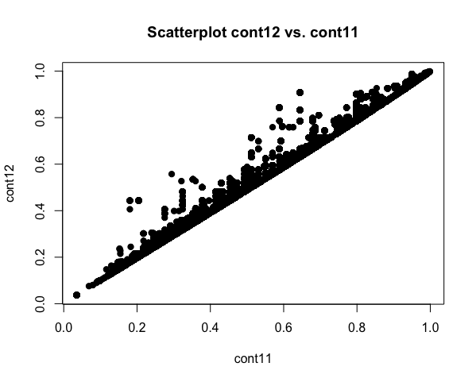

Slide 8
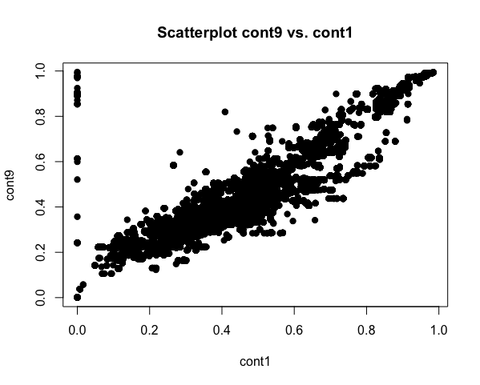
Notes:
jljljljlkj

Slide 9
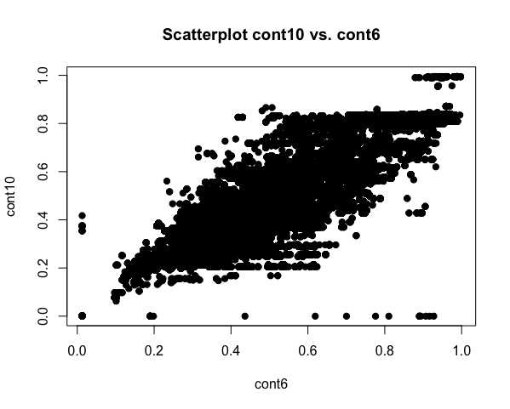

Slide 10
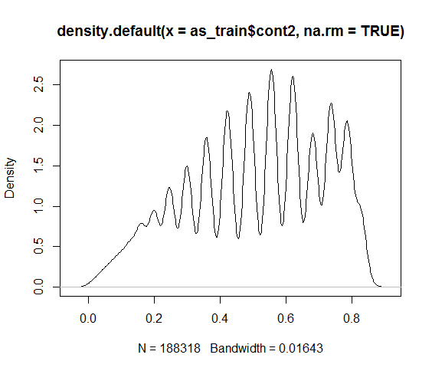

Slide 11
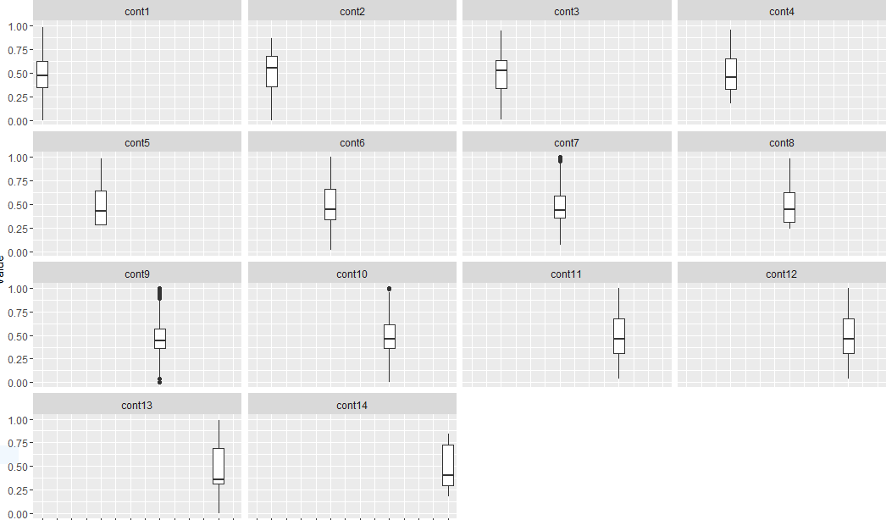

Slide 12
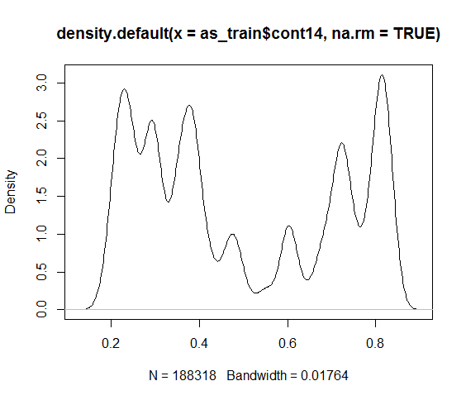

Slide 13
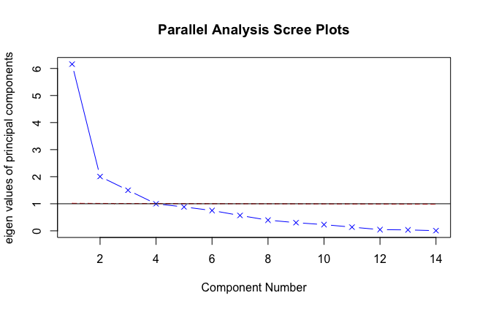
Notes:
1 way to determine # of components in dataset is to examine scree pot of the eigenvalues (mag&dir)

Slide 14
Principal Components Analysis
Call: principal(r = st[c(129:142)], nfactors = 3, residuals = TRUE,
rotate = "none")
Standardized loadings (pattern matrix) based upon correlation matrix
PC1 PC2 PC3
cont1 0.86 -0.23 -0.04
cont2 0.02 0.38 0.74
cont3 -0.35 0.74 0.38
cont4 0.33 -0.57 0.45
cont5 -0.15 - 0.19 0.60
cont6 0.96 0.04 -0.06
cont7 0.63 0.59 -0.17
cont8 0.51 -0.30 0.44
cont9 0.88 -0.21 -0.02
cont10 0.91 -0.03 0.01
cont11 0.84 0.44 0.03
cont12 0.85 0.42 0.02
cont13 0.76 -0.20 0.00
cont14 0.07 -0.05 -0.08
PC1 PC2 PC3
SS loadings 6.16 2.00 1.50 eigen values of components (magnitude and direction)
Proportion Var 0.44 0.14 0.11 PC1 explains 44% of variability
Cumulative Var 0.44 0.58 0.69 PC2 explains 14%
Proportion Explained 0.64 0.21 0.16 PC3 explains 11%
Cumulative Proportion 0.64 0.84 1.00 All 3 explain 69%
Mean item complexity = 1.6
Test of the hypothesis that 3 components are sufficient.
The root mean square of the residuals (RMSR) is 0.07
Fit based upon off diagonal values = 0.97
Should 4th component be extracted?
[1] 6.158504761 2.004966733 1.499272561 0.995995109 0.882372169
[6] 0.750377613 0.566765246 0.394354906 0.300828147 0.228558295
[11] 0.136052628 0.043266719 0.033515221 0.005169893

Slide 15
Linear Regression
Removed the columns of continuous variables with correlation >0.75
So I removed: 4 cont columns
Removed the columns of binary levels which one of the level contains < 1% records: 29 category columns removed
Ex: cat22: A:188275 B: 43
3. Removed the columns of category variables which have highly dependent to other category variables (can be explained >75%)
24 columns of category columns removed

Slide 16
The dependency was determined by:
GKtau(as_train_f09$cat3,as_train_f09$cat90)
xName yName Nx Ny tauxy tauyx
as_train_f09$cat3 as_train_f09$cat90 2 7 0.923 1
And the columns were removed by X-square test on these two columns
4. BoxCox transformed the loss variable.
Lambda = 0.1

Slide 17
5. Preprocess to cut columns which has <5% rows to avoid the singularity on linear regression process.
6. Adjusted R-squared: 0.50

Slide 18
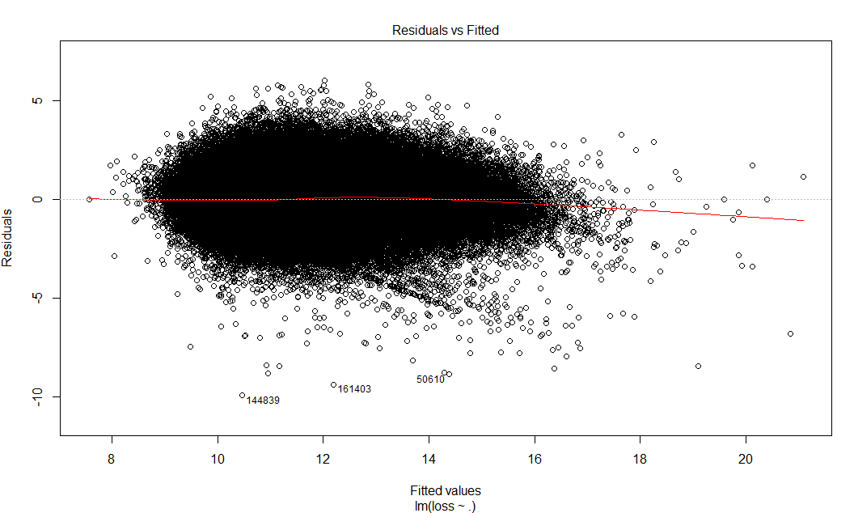
7. Residual Plot:

Slide 19
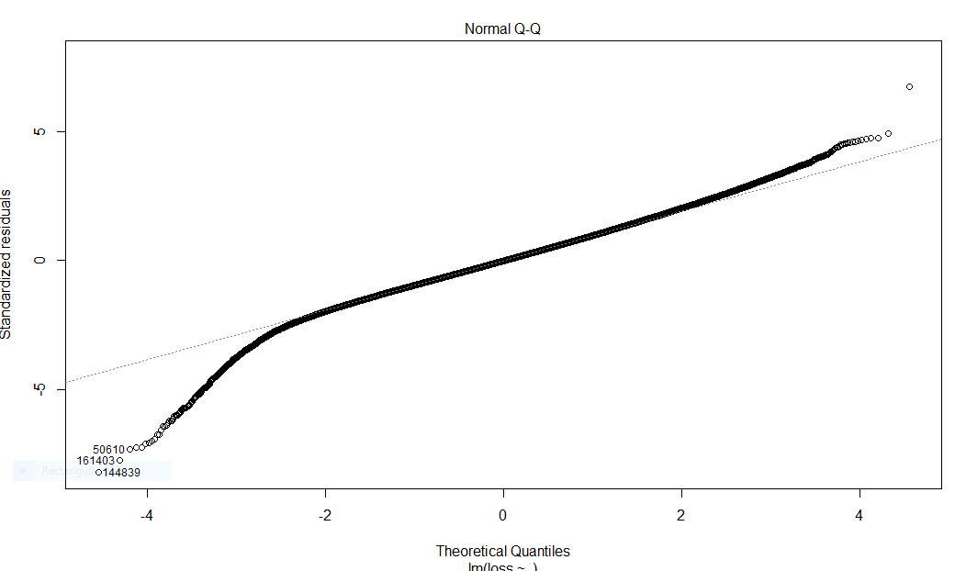

Slide 20
The plots show:
Residual shows pattern
Residual is not normally distributed
The simple run of the lm does not give much predict power
Power transformation and feature combination have been tried to reduce non-normal distribution and did not show much improvement so far.

Slide 21
Machine Learning
Linear Regression (lm)
Lasso (glmnet)
Stochastic Gradient Boosting (gbm)
eXtreme Gradient Boosting (xgboost)

Slide 22
Work Flow
Pre-processing
Data Splitting
Model Tuning Using Resampling
Fitting Models
Predict

Slide 23
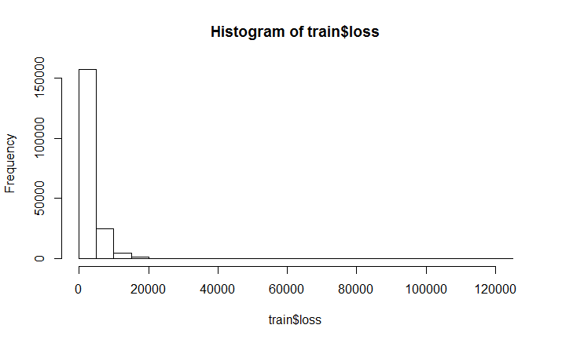
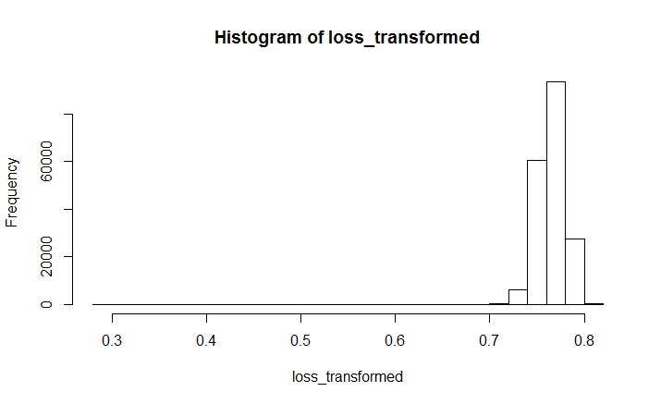
Pre-processing
Data Transformation: log(loss)
Creating Dummy Variables
Excluding near zero-variance predictors

Slide 24
Data Splitting
Creating Partition of 80 percent for training data from train dataset.
20 percent for testing.

Slide 25
Resampling Method and Tuning
Repeated Cross-Validation
10-fold cv
Repeats 3 times.
gbm
n.trees = 100, 150, 200, 250,...500, interaction.depth = 1,3,5,7, shrinkage = 0.01, n.minobsinnode = 20
glmnet (lasso)
lambda range from 0.01 to 100,000 with 100 equal space
xgboost
nrounds = 1000, max_depth = 4,6,8,10,12,14,16, eta = 0.01, gamma = 1, colsample_bytree = 0.5, min_child_weight = 80,100,120, subsample = 0.7
Metric: RMSE (Root mean square error)

Slide 26
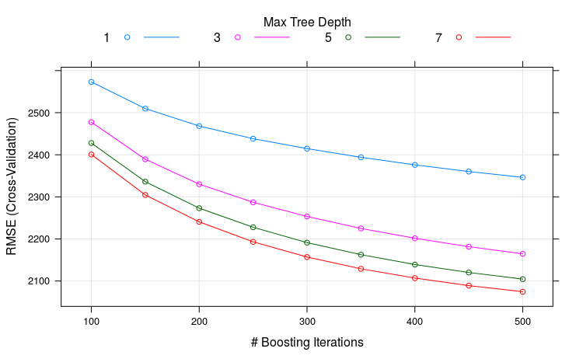
Gradient Boosting
Fitting n.trees = 500, interaction.depth = 7, shrinkage = 0.01, n.minobsinnode = 20
RMSE = 2074.632

Slide 27
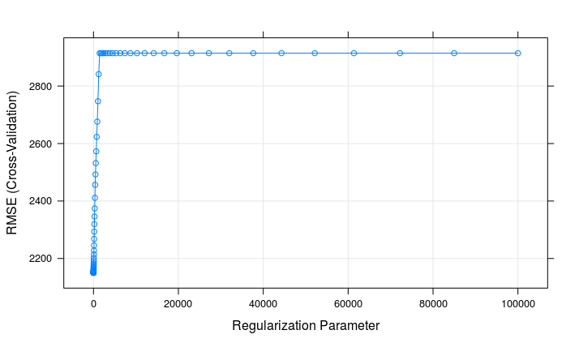
Lasso
alpha = 1, lambda = 0.221
RMSE = 2085.1974905 Rsquared = 0.4679428 MAE = 1351.189

Slide 28
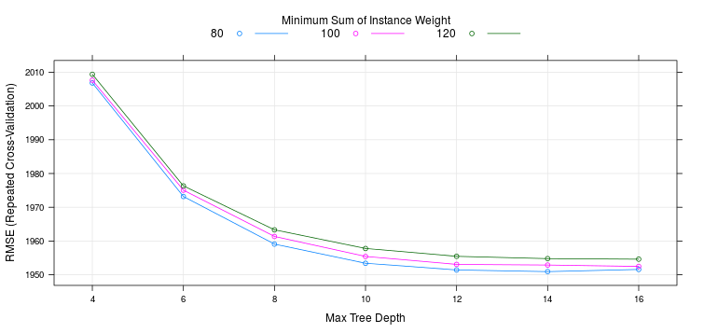
eXtreme Gradient Boosting
nrounds = 1000, max_depth = 14, eta = 0.01, gamma = 1, colsample_bytree = 0.5, min_child_weight = 80, subsample = 0.7

Slide 29
eXtreme Gradient Boosting
max_depth min_child_weight RMSE Rsquared
14 80 1950.950 0.5523391
Mean Square Error
> sum(abs(predicted - lossTest)) / length(lossTest)
[1] 1199.845

Slide 30
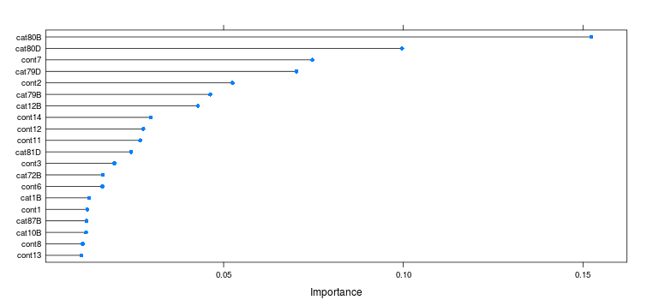
Variance Importance

Slide 31
Overfitting
Xgboost Mean square error on 20% test data is 1199.845, submission MAE is 1343.23
Severely overfitted.
Reason:
Only one data splitting. More.
Test dataset may have additional level in categorical variable.
example : cat92 -- 7 (train) vs. 8 (test), cat103 -- 13 (train) vs. 14 (test)
Ensemble

Slide 32
Conclusion
Best Model: xgboost
Variable importance to determine which feature impact loss more

